Slide 1
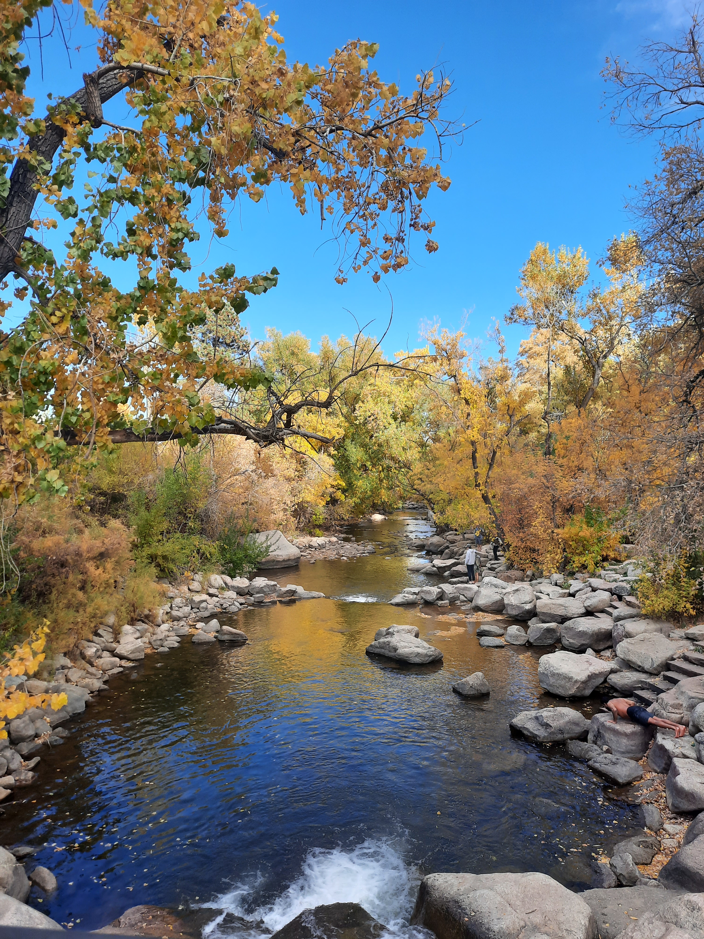





Rivers & Rocks
Integrating Channel Adjustments, Gravel Attrition, and Bedrock Wear in a Model of Long-Profile Evolution
Vanessa Gabel^{1, 2} and Greg Tucker^{1, 2}
¹Cooperative Institute for Research in Environmental Sciences
²Department of Geological Sciences, University of Colorado, Boulder
12 Dec 2022

Slide 2
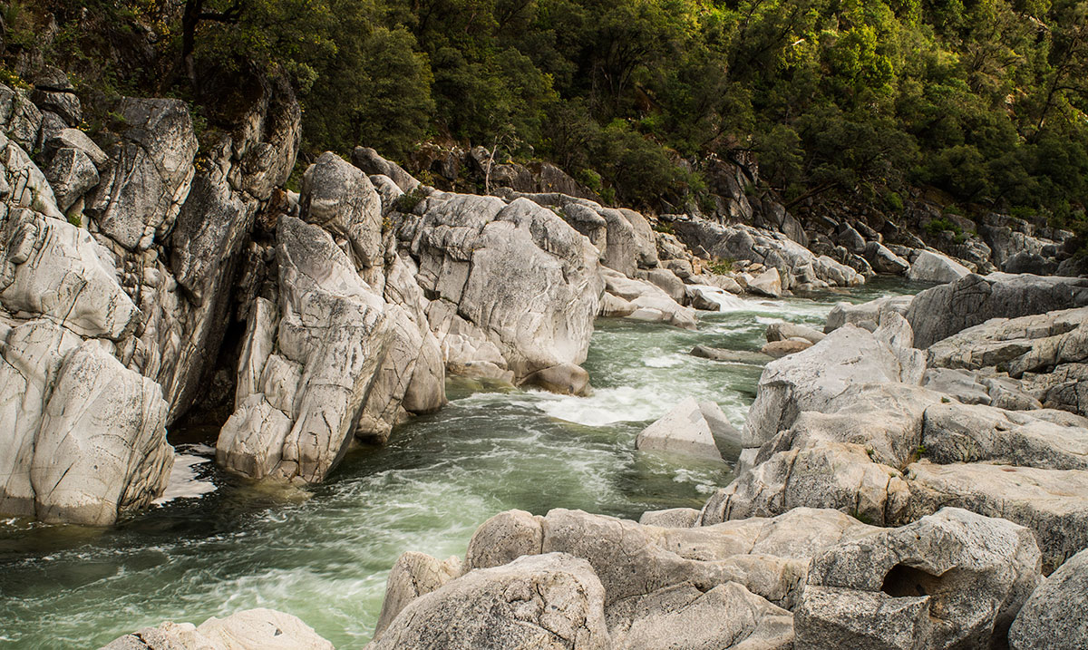
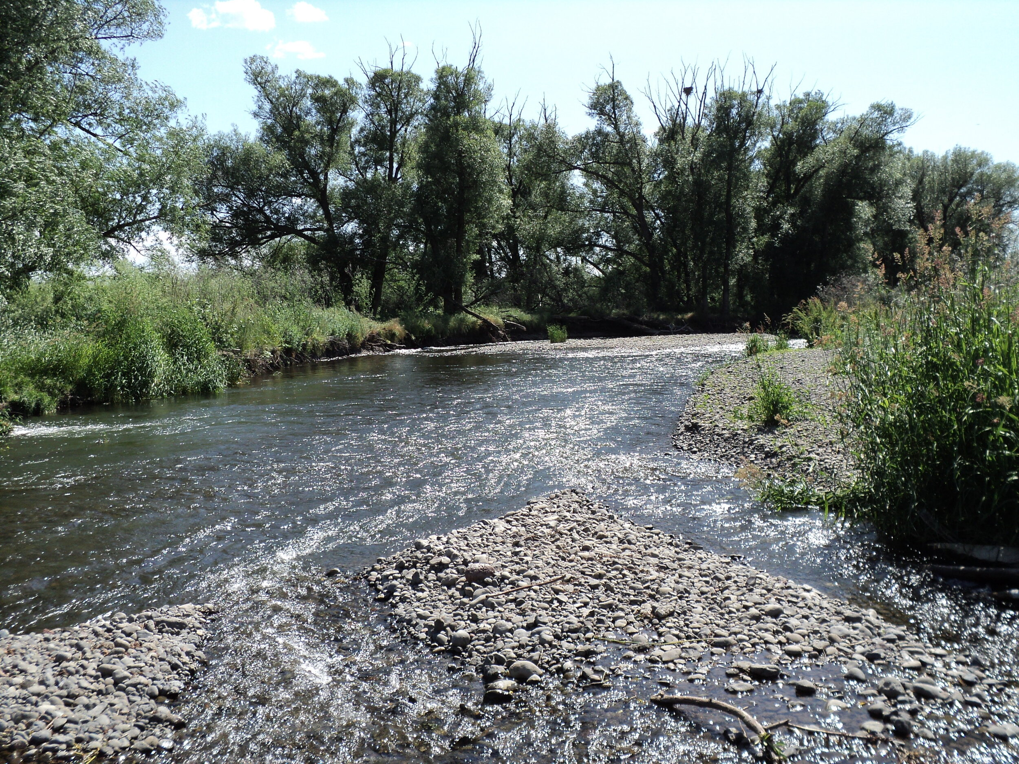
We often conceptualize rivers in terms of end-member behaviors and morphologies
Width is confined
Detachment-limited, incise bedrock
Slope scales with bedrock properties and discharge
Sediment is exported rapidly; often neglected
Bedrock
South Yuba River, Daniel Nylen
“Threshold channels” → width is self-adjusted
Transport-limited
Slope graded to sediment transport
Sediment subject to selective transport and grain attrition
Alluvial
Mill Creek, The Science of Rivers

Slide 3
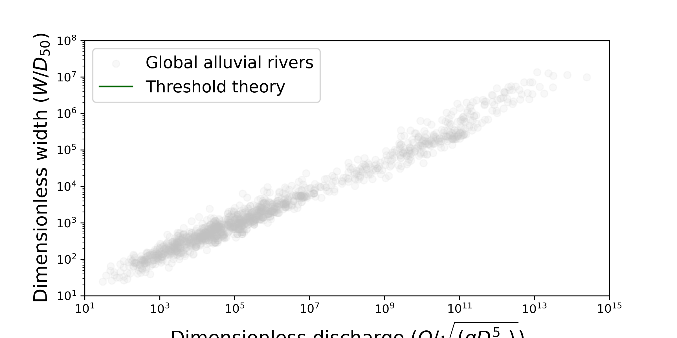
But are all “alluvial rivers” actually alluvial rivers?
Dimensionless discharge (Q/√(gD₅₀⁵))
Modified from Phillips et al., 2022

Slide 4
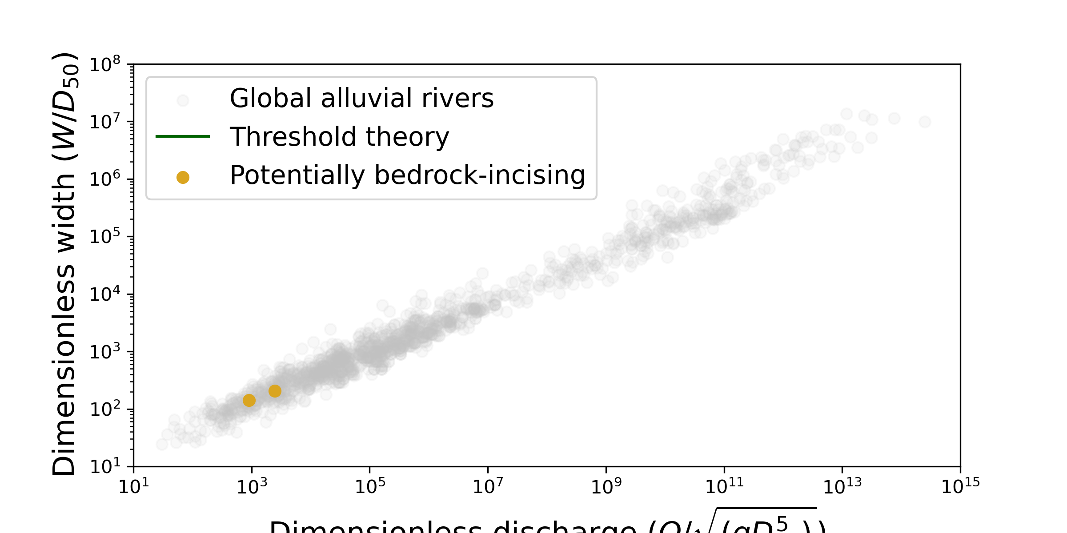
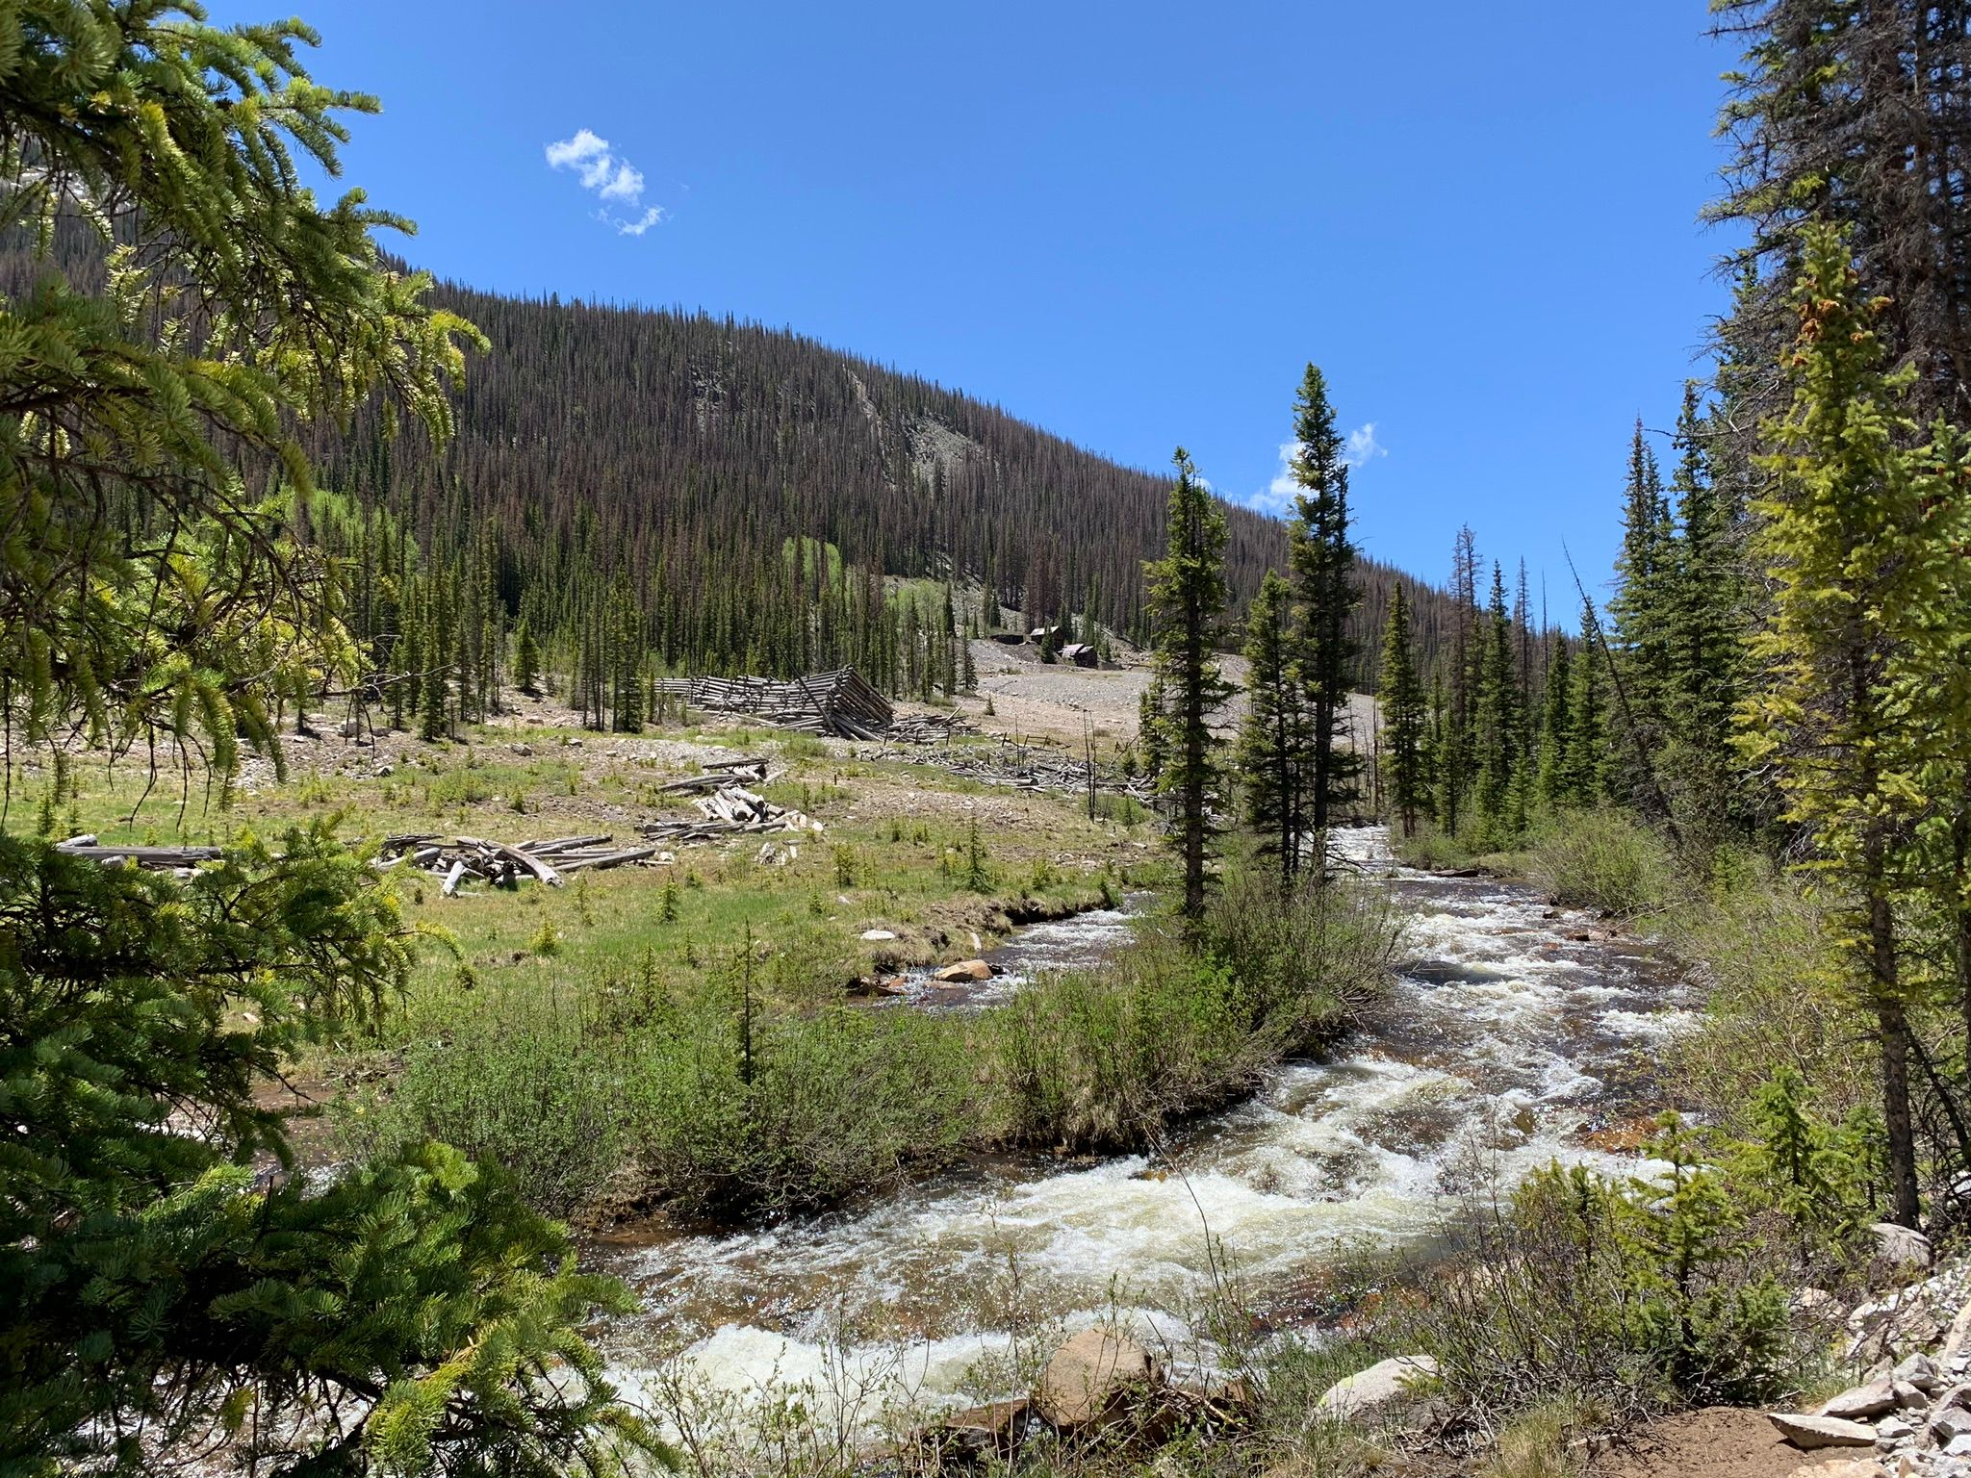
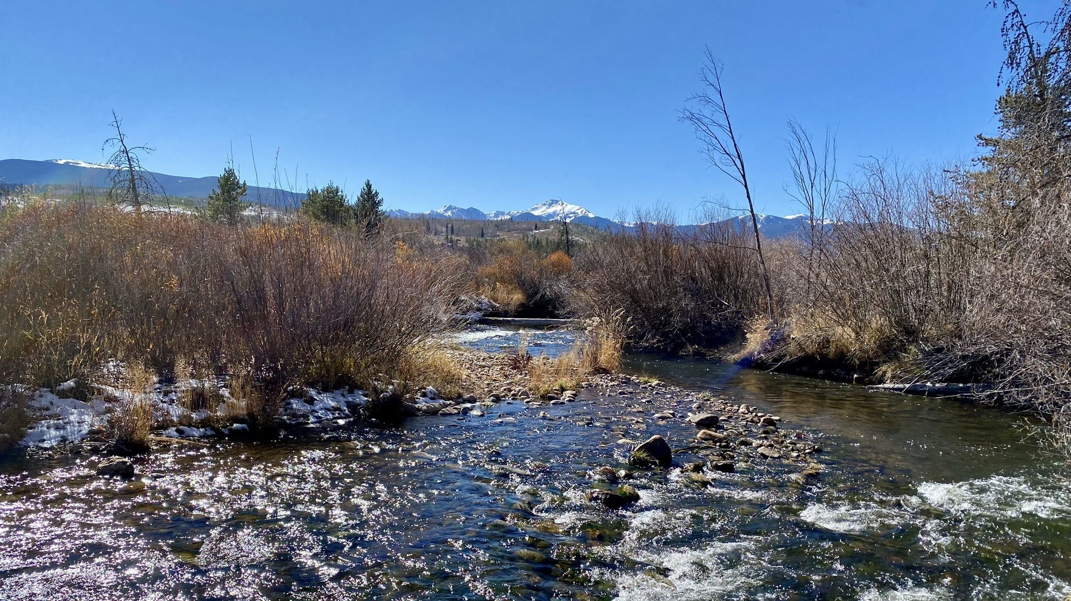
But are all “alluvial rivers” actually alluvial rivers?
1
1
2
Chalk Creek, James Sanders
Dimensionless discharge (Q/√(gD₅₀⁵))
2
Modified from Phillips et al., 2022
Some of these “near-threshold” rivers are incising bedrock!
So what?
Fraser River, Kamie Hartley

Slide 5
But are all “alluvial rivers” actually alluvial rivers?
1
We need a model that accomplishes bedrock erosion while also allowing self-adjusted width and depth!
1
2
Chalk Creek, James Sanders
Dimensionless discharge (Q/√(gD₅₀⁵))
2
Modified from Phillips et al., 2022
Some of these “near-threshold” rivers are incising bedrock!
So what?
Fraser River, Kamie Hartley

Slide 6
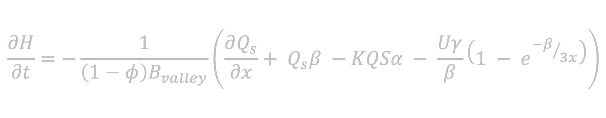
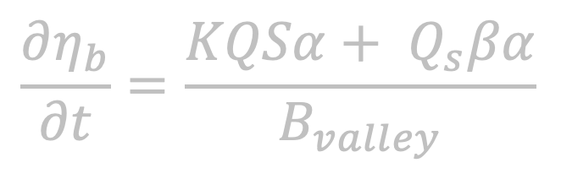
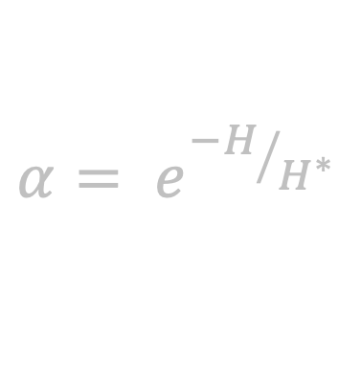
Our model runs on three governing equations that describe bedrock erosion and sediment transport processes
$$\frac{∂η_{b}}{∂t}=\frac{KQSα+ Q_{s}βα}{B_{valley}}$$
$$\frac{∂H}{∂t}=−\frac{1}{\left(1−φ\right)B_{valley}}\left(\frac{∂Q_{s}}{∂x}+ Q_{s}β −KQSα − \frac{Uγ}{β}\left(1 − e^{{−β}/{3x}}\right)\right)$$
$$α= e^{{−H}/{H^{∗}}}$$

Slide 7
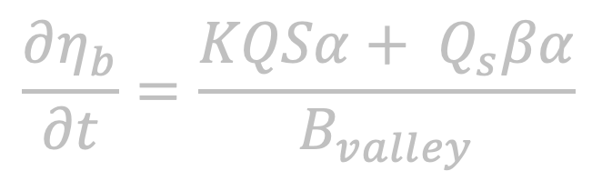
$$\frac{∂η_{b}}{∂t}=\frac{KQSα+ Q_{s}βα}{B_{valley}}$$

Slide 8
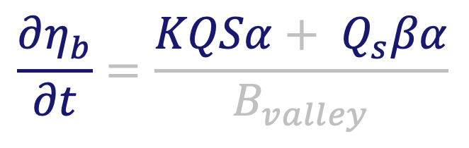
Plucking
Abrasion
Change in bedrock elevation
$$\frac{∂η_{b}}{∂t}=\frac{KQSα+ Q_{s}βα}{B_{valley}}$$

Slide 9

$$\frac{∂H}{∂t}=−\frac{1}{\left(1−φ\right)B_{valley}}\left(\frac{∂Q_{s}}{∂x}+ Q_{s}β −KQSα − \frac{Uγ}{β}\left(1 − e^{{−β}/{3x}}\right)\right)$$

Slide 10
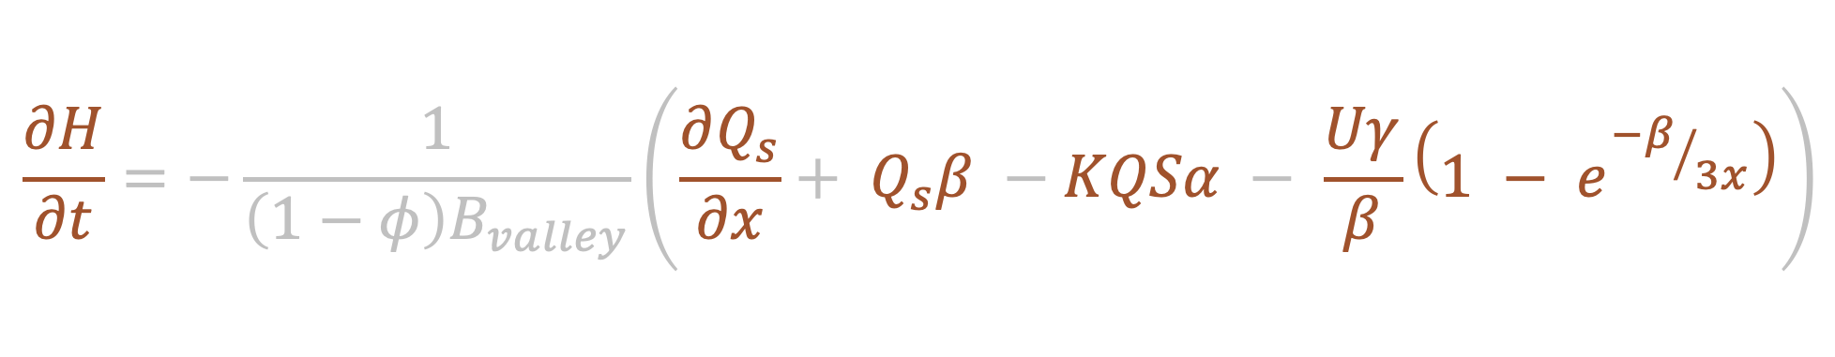
Change in sediment thickness
Sediment flux
Plucking
$$\frac{∂H}{∂t}=−\frac{1}{\left(1−φ\right)B_{valley}}\left(\frac{∂Q_{s}}{∂x}+ Q_{s}β −KQSα − \frac{Uγ}{β}\left(1 − e^{{−β}/{3x}}\right)\right)$$
Gravel attrition
Lateral sediment supply

Slide 11
$$α= e^{{−H}/{H^{∗}}}$$

Slide 12
Bed exposure fraction
Sediment thickness ratio
$$α= e^{{−H}/{H^{∗}}}$$

Slide 13
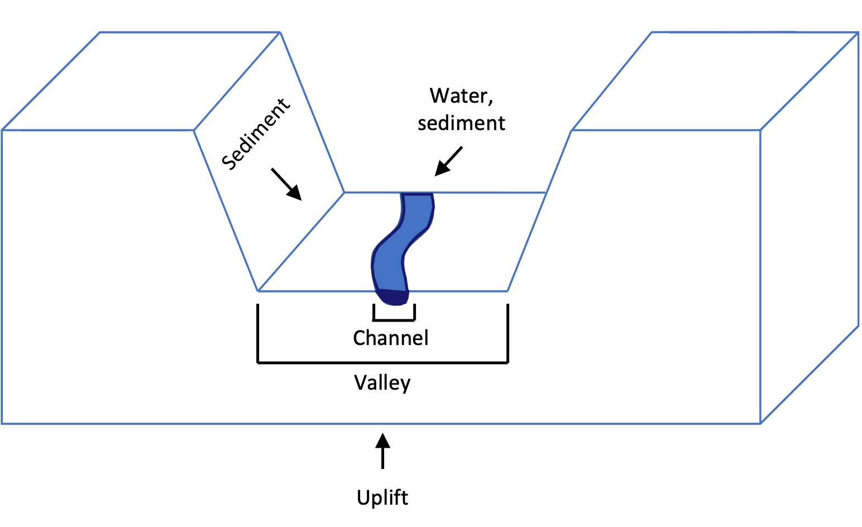


Our model builds upon previous near-threshold models
Water, sediment
Sediment
Channel
Valley
Modified from Wickert and Schildgen, 2019
Rock uplift
Notes:
Bedload sediment transport in equilibrium channels
Channel width adjustment to flow and sediment characteristics
Abrasion of bedrock by mobile sediment
Plucking of sediment
Sediment cover effects
Loss of gravel-sized sediment via grain attrition

Slide 14
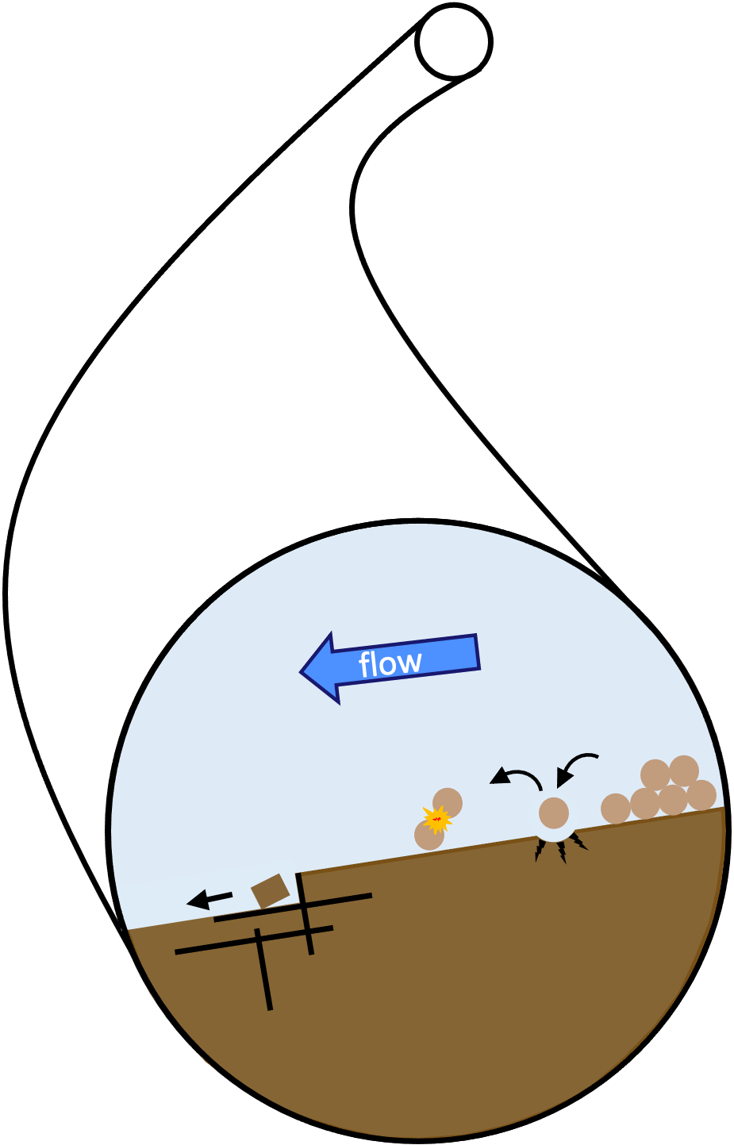



Our model builds upon previous near-threshold models
Water, sediment
Sediment
Channel
Valley
Modified from Wickert and Schildgen, 2019
Rock uplift
Uplift
Notes:
Bedload sediment transport in equilibrium channels
Channel width adjustment to flow and sediment characteristics
Abrasion of bedrock by mobile sediment
Plucking of sediment
Sediment cover effects
Loss of gravel-sized sediment via grain attrition

Slide 15

Our model builds upon previous near-threshold models
Water, sediment
Sediment
H*
Channel
Valley
Modified from Wickert and Schildgen, 2019
Uplift
Rock uplift
Notes:
Bedload sediment transport in equilibrium channels
Channel width adjustment to flow and sediment characteristics
Abrasion of bedrock by mobile sediment
Plucking of sediment
Sediment cover effects
Loss of gravel-sized sediment via grain attrition

Slide 16
A
Water, sediment
Sediment
H*
Channel
Valley
C
Uplift
Rock uplift
B
Notes:
Duplicating this slide to make adjustments for manuscript

Slide 17
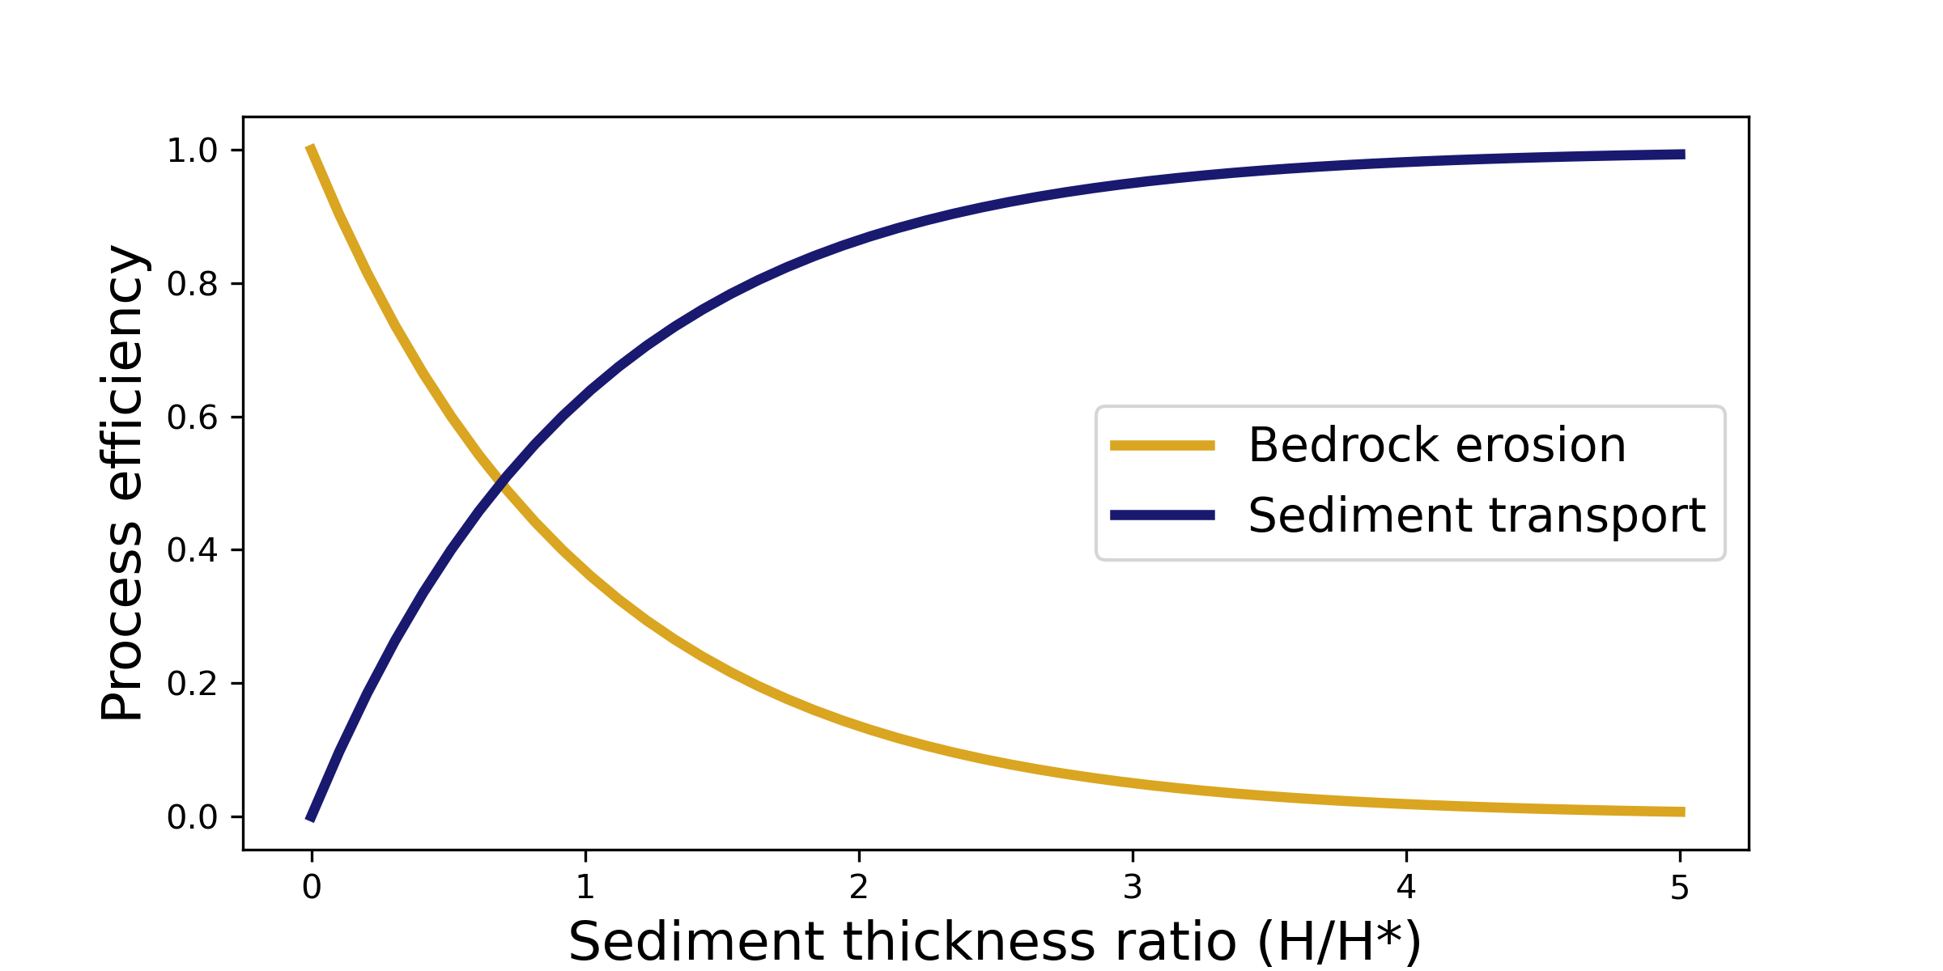
Our model builds upon previous near-threshold models
Water, sediment
Sediment
H*
Channel
Valley
Modified from Wickert and Schildgen, 2019
Uplift
Rock uplift
Modified from Shobe et al., 2017
Notes:
Bedload sediment transport in equilibrium channels
Channel width adjustment to flow and sediment characteristics
Abrasion of bedrock by mobile sediment
Plucking of sediment
Sediment cover effects
Loss of gravel-sized sediment via grain attrition

Slide 18
Can our model account for expected fluvial behavior?
Notes:
Show single lithology cases both for these plots and analytical solutions (if shown at all) – save this two lith stuff for last slide (future applications)

Slide 19
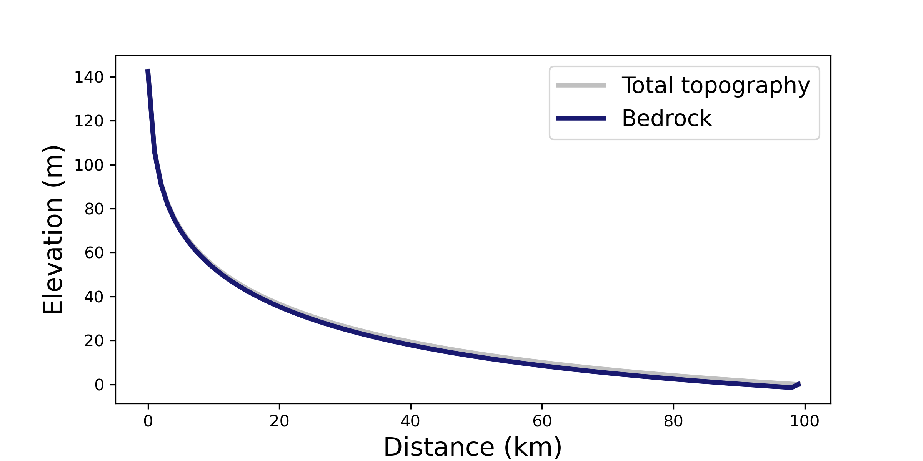
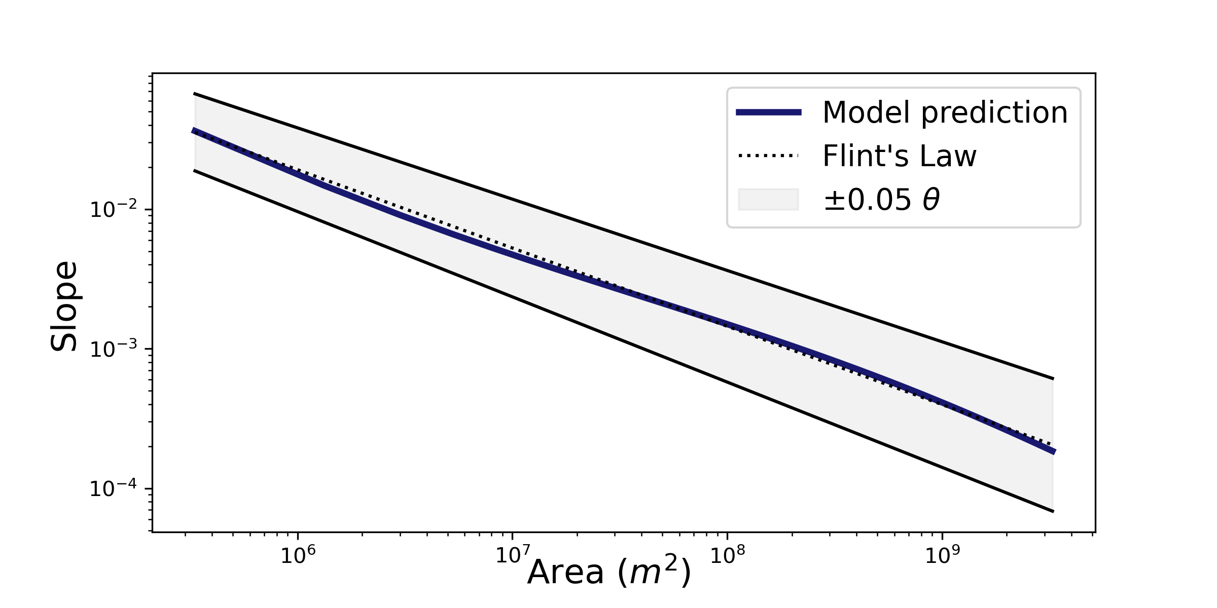
Can our model account for expected fluvial behavior?
Slope - Area Scaling
Notes:
Show single lithology cases both for these plots and analytical solutions (if shown at all) – save this two lith stuff for last slide (future applications)

Slide 20
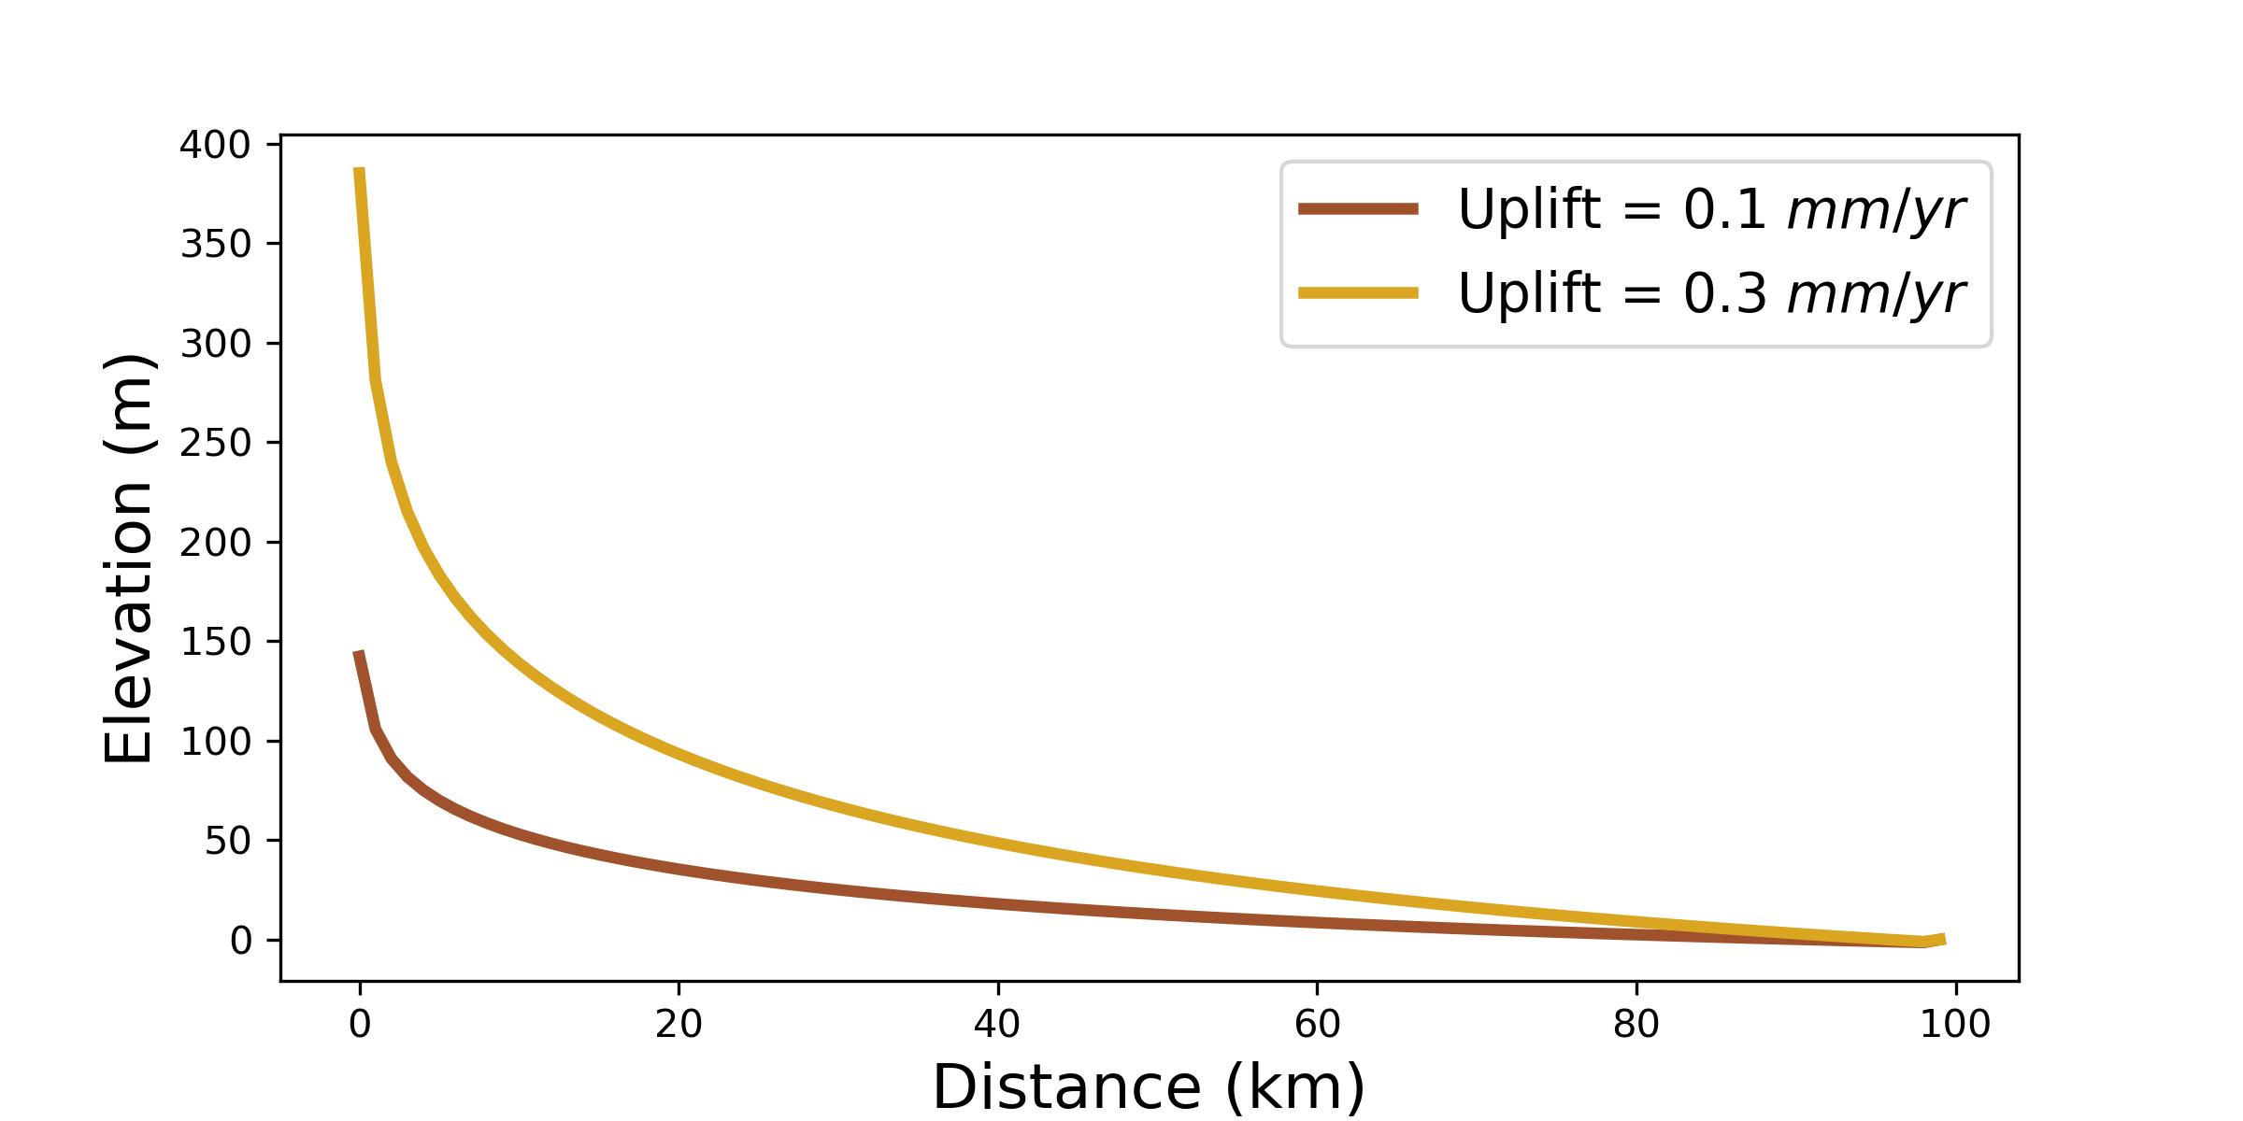
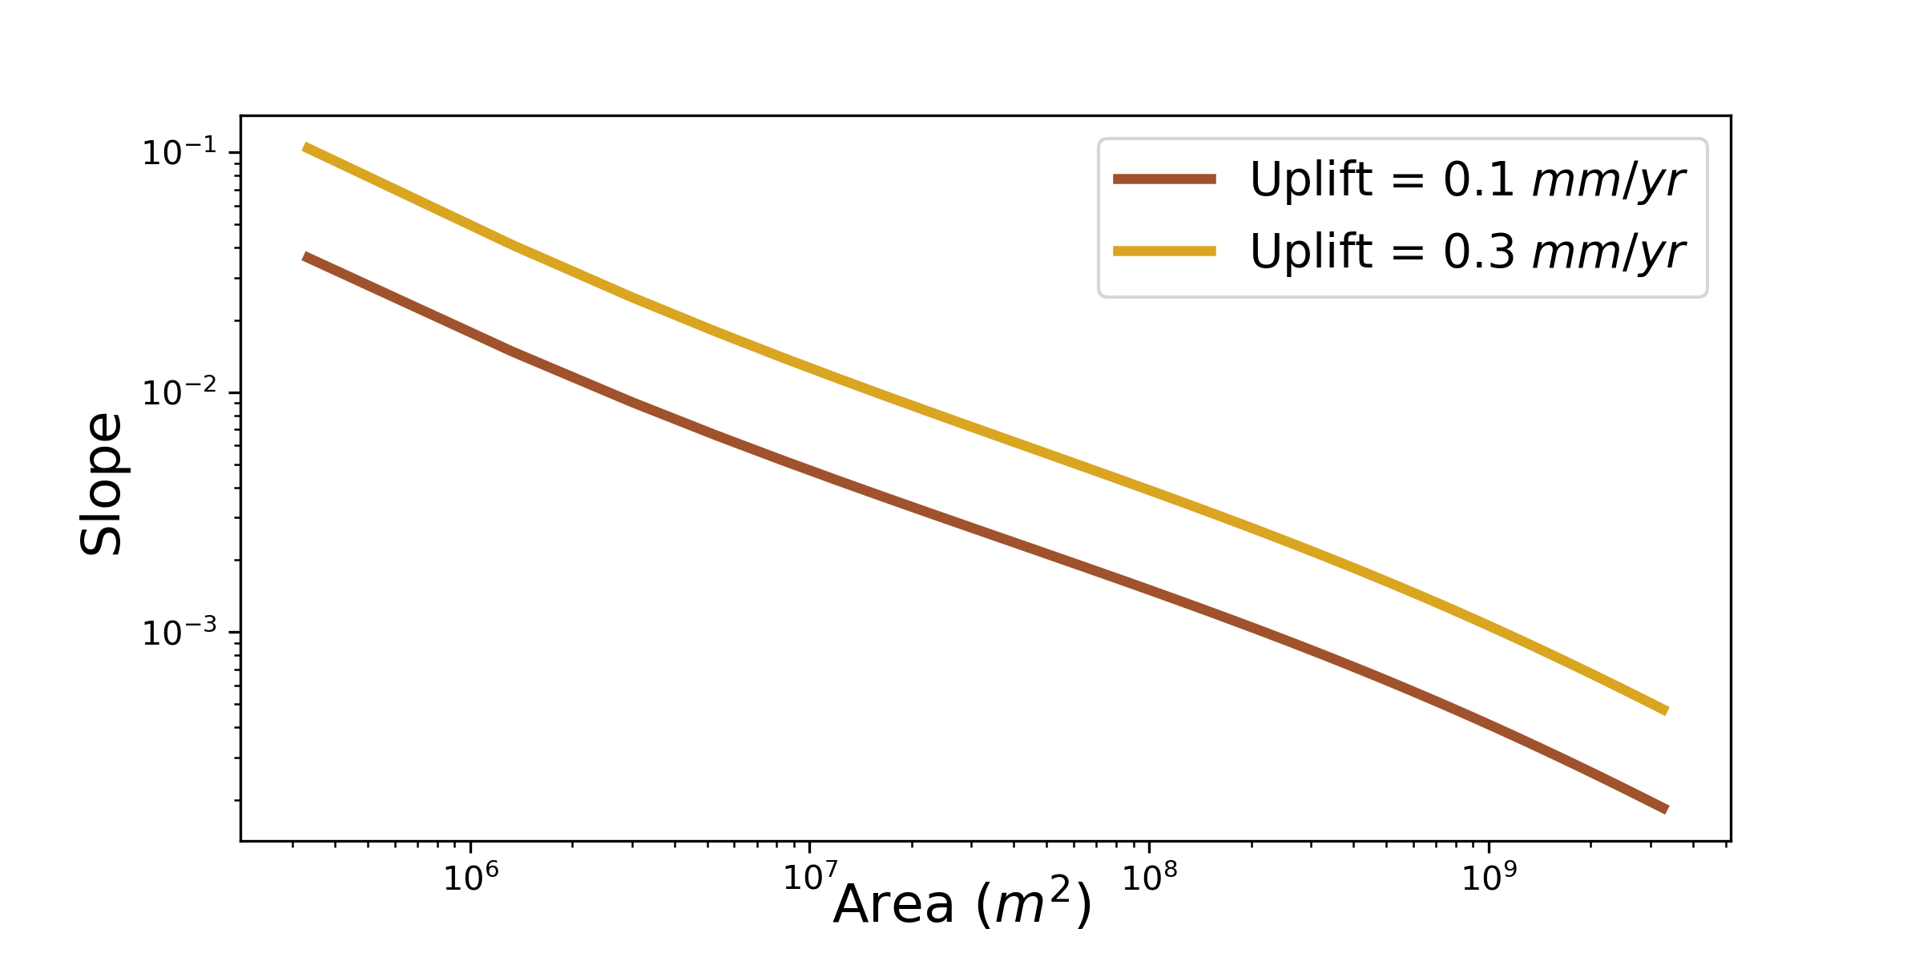
Can our model account for expected fluvial behavior?
Slope - Area Scaling
Steepness – Uplift
Notes:
Show single lithology cases both for these plots and analytical solutions (if shown at all) – save this two lith stuff for last slide (future applications)

Slide 21
Do our rivers “look” alluvial?

Slide 22
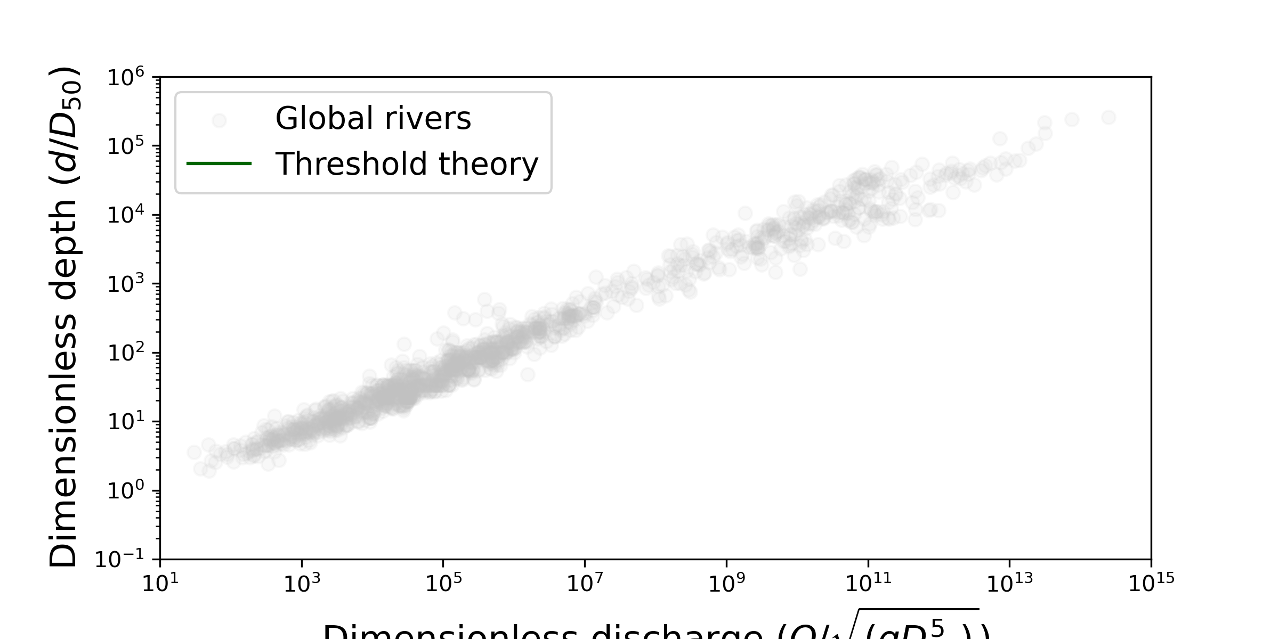
Do our rivers “look” alluvial?
Dimensionless discharge (Q/√(gD₅₀⁵))
Dimensionless discharge (Q/√(gD₅₀⁵))
Figures modified from Phillips et al., 2022

Slide 23
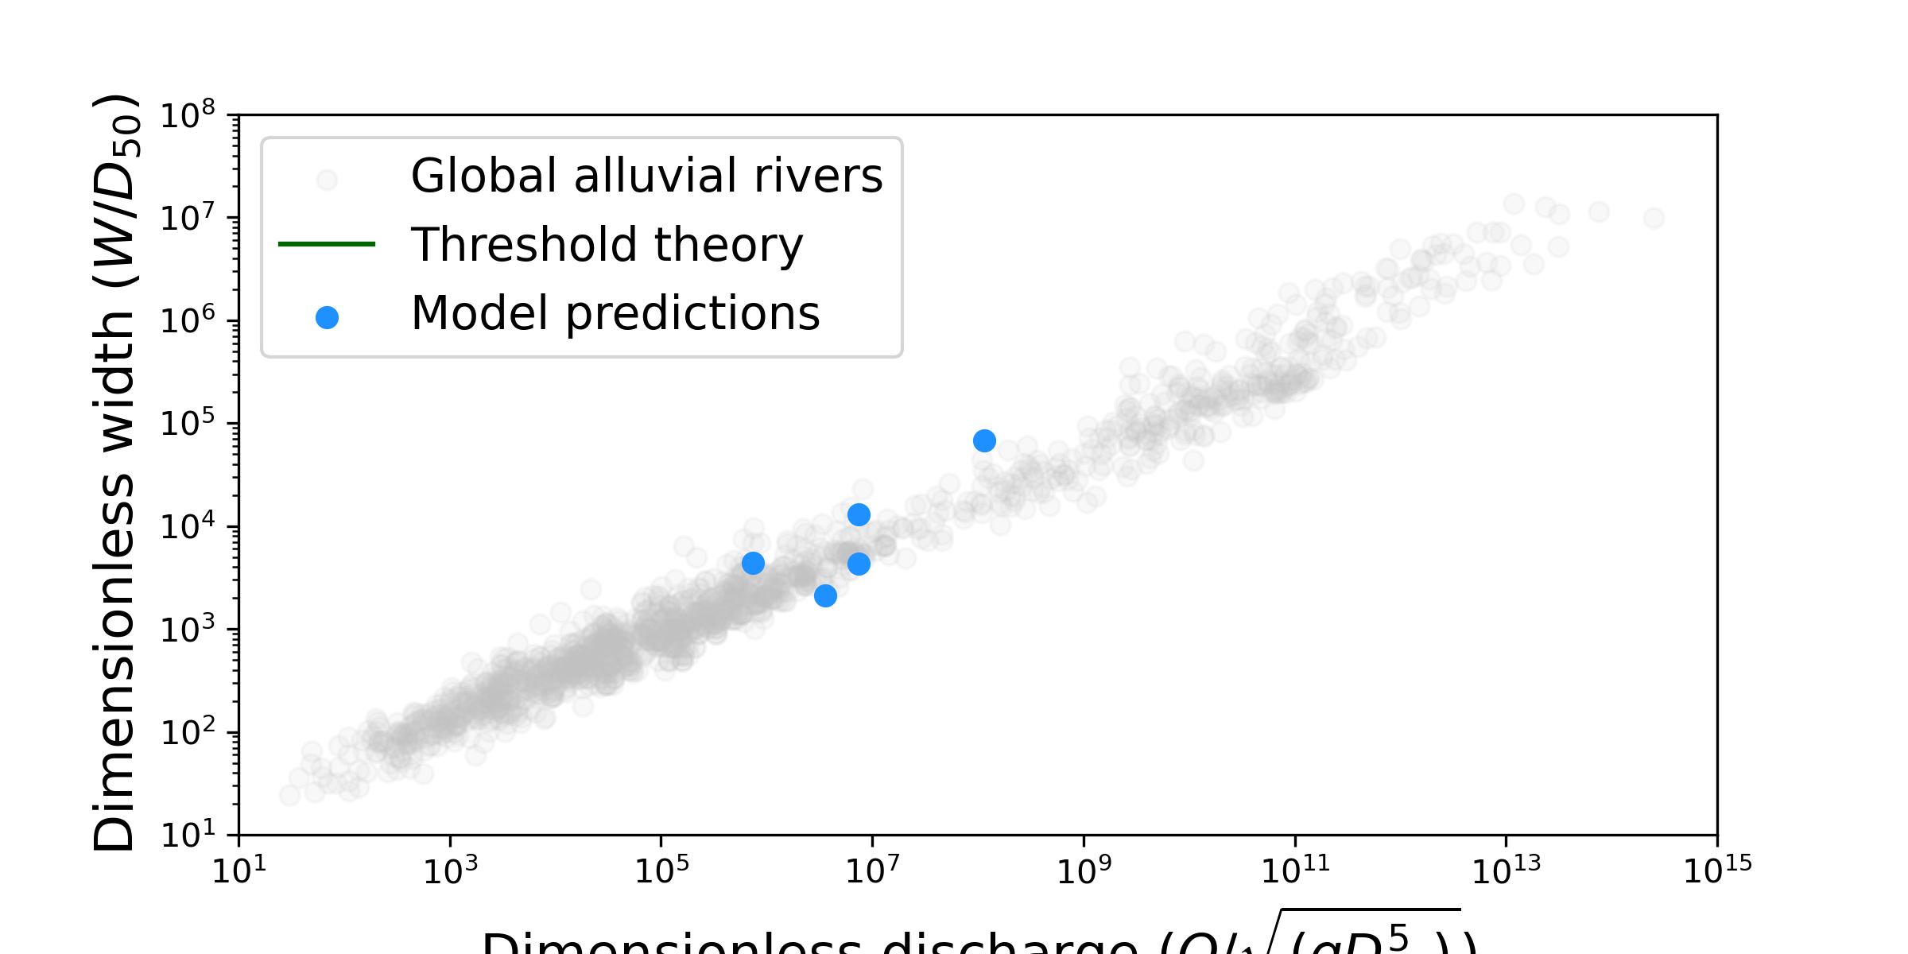
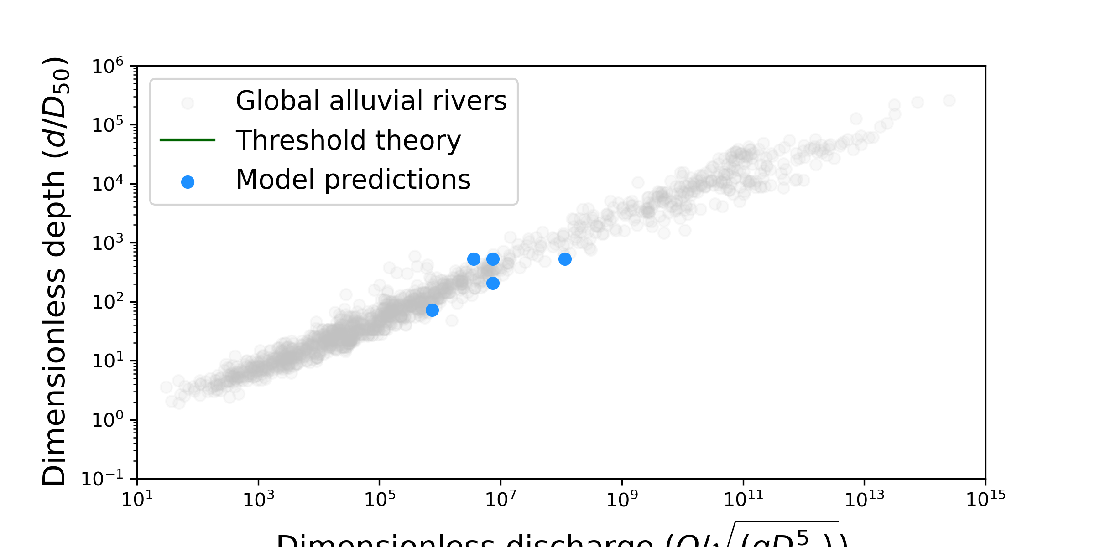
Do our rivers “look” alluvial?
Dimensionless discharge (Q/√(gD₅₀⁵))
Dimensionless discharge (Q/√(gD₅₀⁵))
Figures modified from Phillips et al., 2022
We’ve created a bedrock-incising model that is consistent with near-threshold (alluvial river) behavior!

Slide 24
We can use our model to make predictions about bedrock-incising alluvial rivers

Slide 25
We can use our model to make predictions about bedrock-incising alluvial rivers
Changing Pluckability (K)

Slide 26
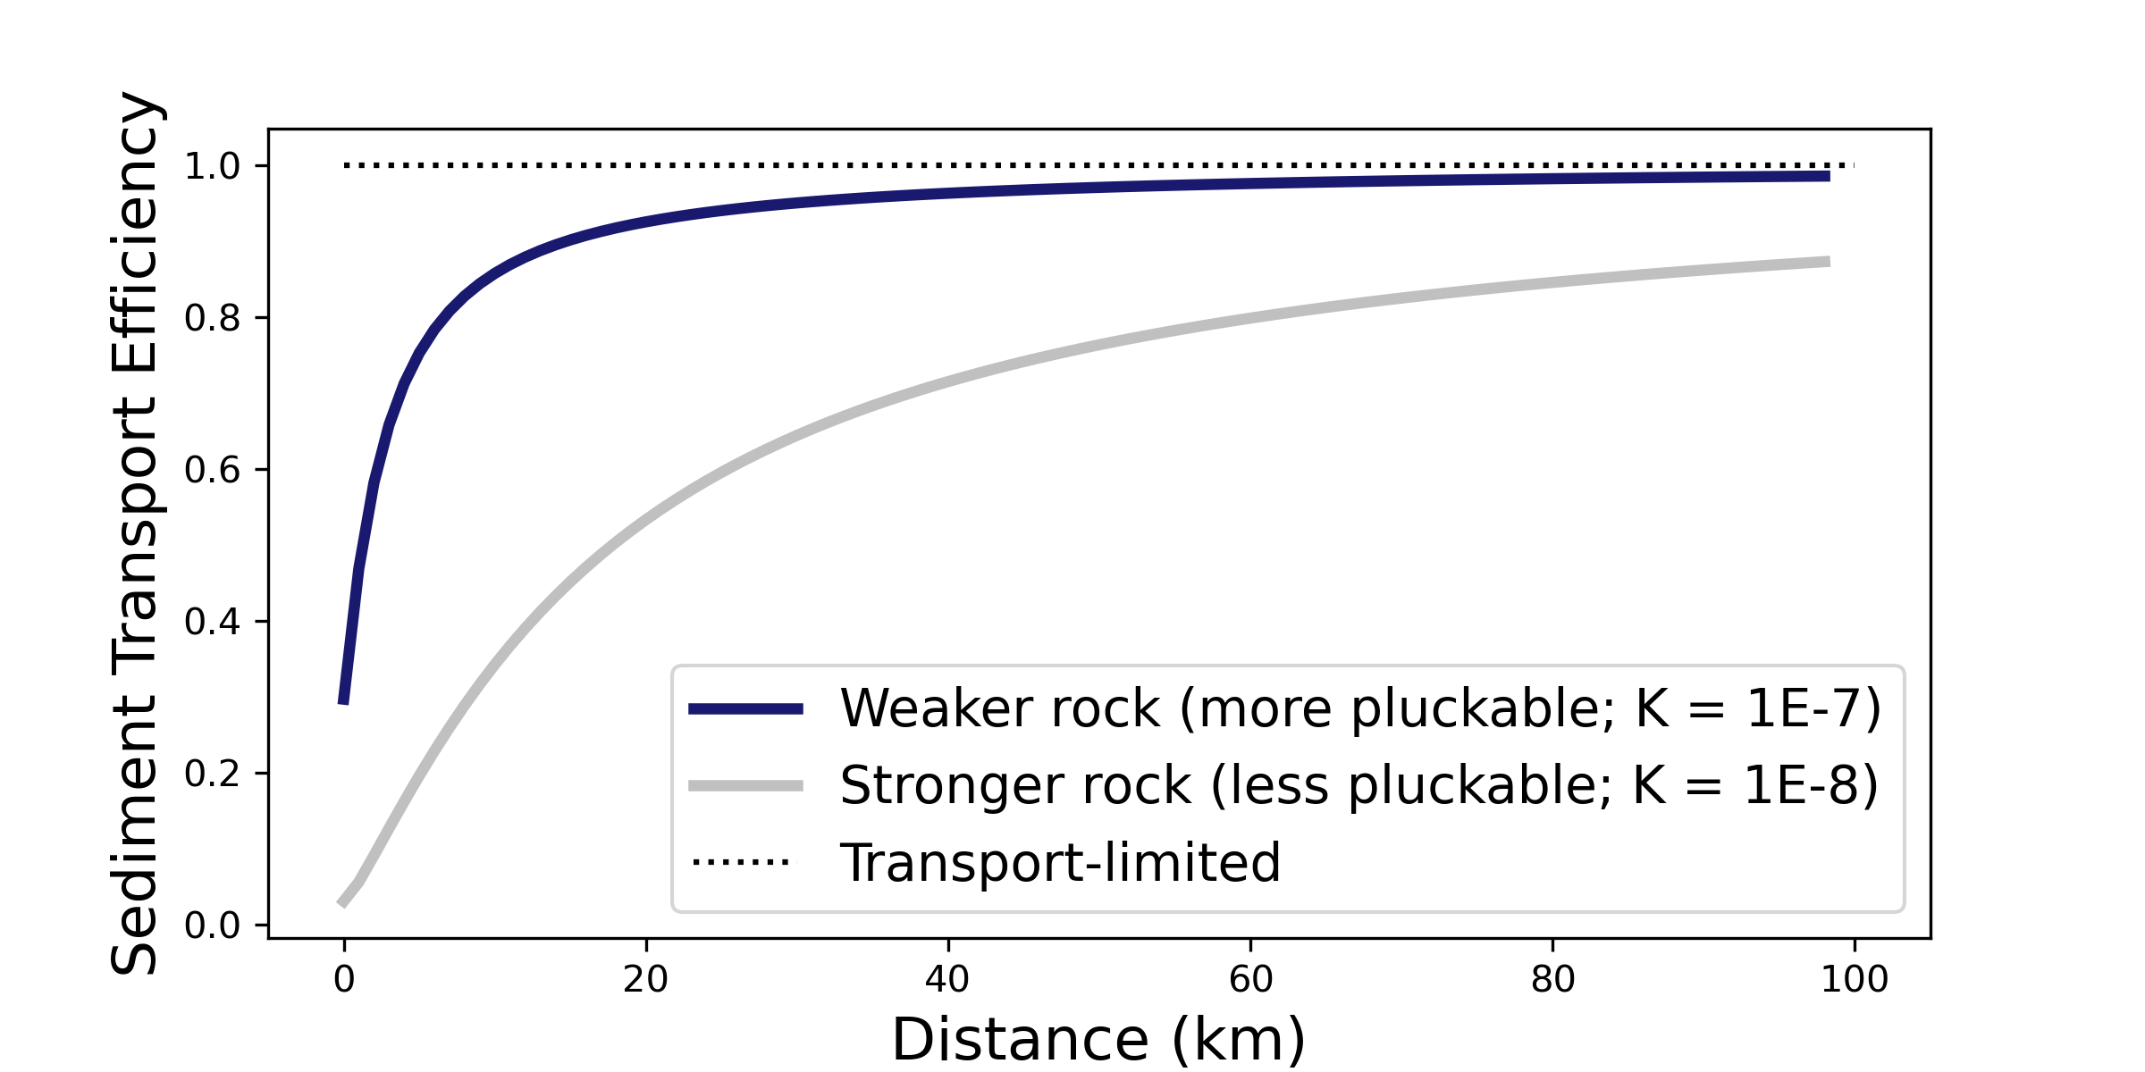
We can use our model to make predictions about bedrock-incising alluvial rivers
Changing Pluckability (K)

Slide 27
We can use our model to make predictions about bedrock-incising alluvial rivers
Changing Pluckability (K)
Changing Abradability
Notes:
Big message:
Changing persistence of sediment can have similar effect as changing bedrock erodibility
Persistence of sediment, not grain size distribution, is the key to switching between TPL and DTL

Slide 28
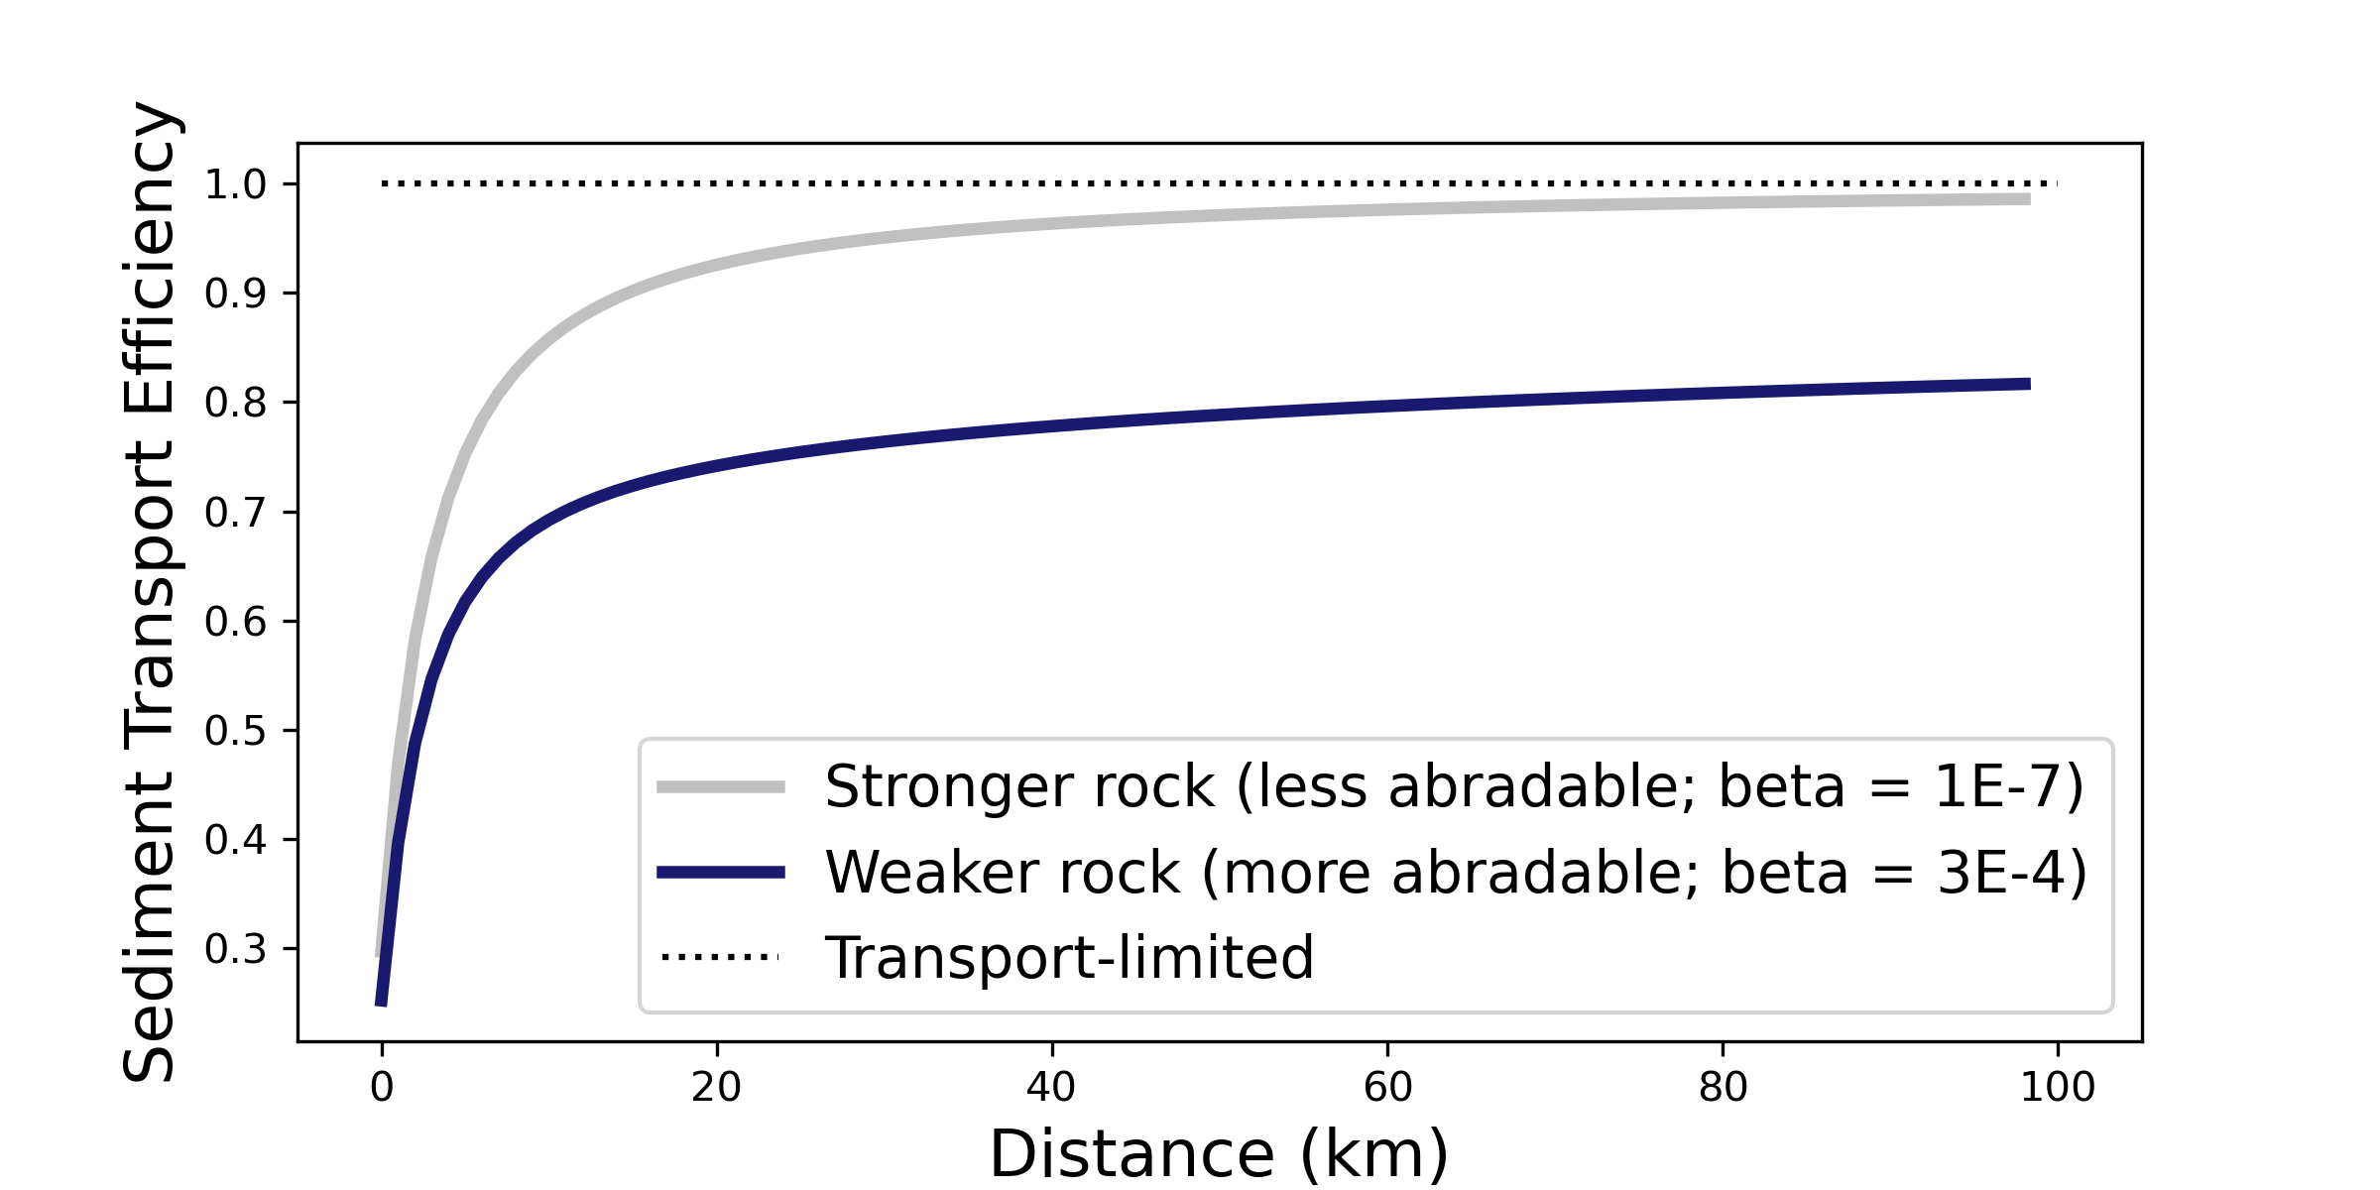
We can use our model to make predictions about bedrock-incising alluvial rivers
Changing Pluckability (K)
Changing Abradability
Notes:
Big message:
Changing persistence of sediment can have similar effect as changing bedrock erodibility
Persistence of sediment, not grain size distribution, is the key to switching between TPL and DTL

Slide 29

We can use our model to make predictions about bedrock-incising alluvial rivers
What kinds of questions can we answer?
Fluvial behavior in plucking-dominated vs abrasion-dominated systems
Fluvial adjustment to large sediment inputs; impacts of sediment persistence
Where does near threshold theory break down?
Changing Pluckability (K)
Changing Abradability
Notes:
Big message:
Changing persistence of sediment can have similar effect as changing bedrock erodibility
Persistence of sediment, not grain size distribution, is the key to switching between TPL and DTL
Sed wearing away faster than can be replenished
Two important things: props of both bedrock and sed important, and scale important

Slide 30
In Summary:
Near-threshold models can be suitable for bedrock-incising (mixed bedrock-alluvial) systems
“Transport-limited” systems can incise bedrock over long timescales
Degree of “transport-limited-ness” is strongly dependent on properties of both bedrock erodibility and sediment abradabilty
NSF EAR #s: 2148762, 2104102, 2140831, 1831623, 1822062
NASA: 80NSSC22K0465

